Slide 1
Circuit Designer Update
Kenneth Shipley, Joseph Spear, Jason Rivas

Slide 2

GUI:
All of the development for the GUI has been done using the PyQt library, and thus all GUI items are related to how PyQt is being utilized.
Completed Items
Partially completed items
Items that still need to be implemented

Slide 3
GUI:
Completed Items
The initial portion of the GUI has been completed, where the window holding all of the buttons and elements will be located. This includes a “Design Page”, a “Convert Page”, and a “File Page”. Each of these pages are made of frames, and will include the various first-glance GUI elements.
The following images have transitions between each one once the connected button is clicked.

Slide 4
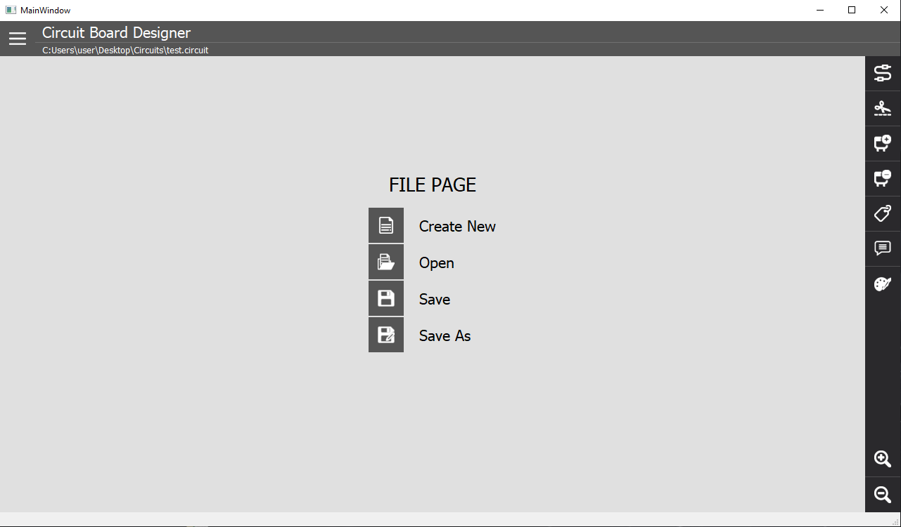

Slide 5
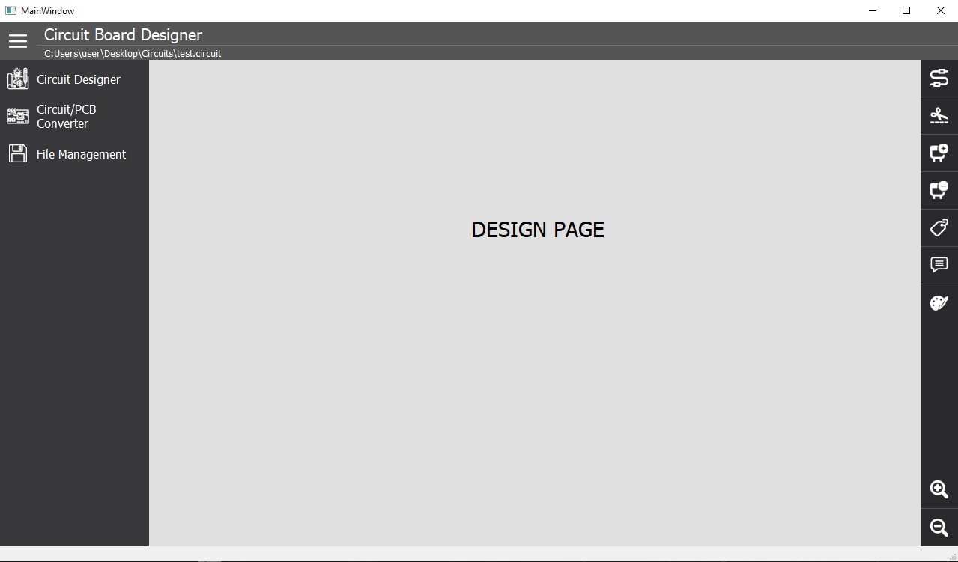

Slide 6
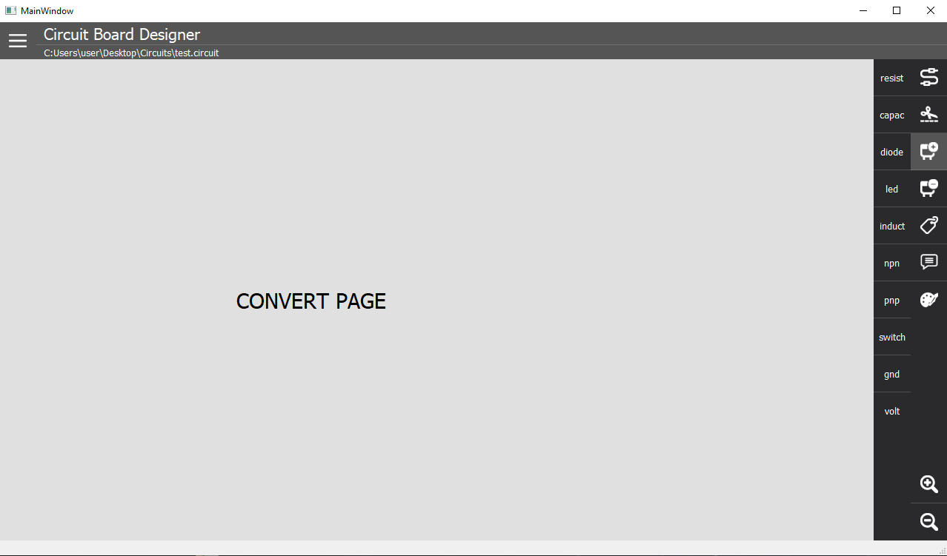

Slide 7
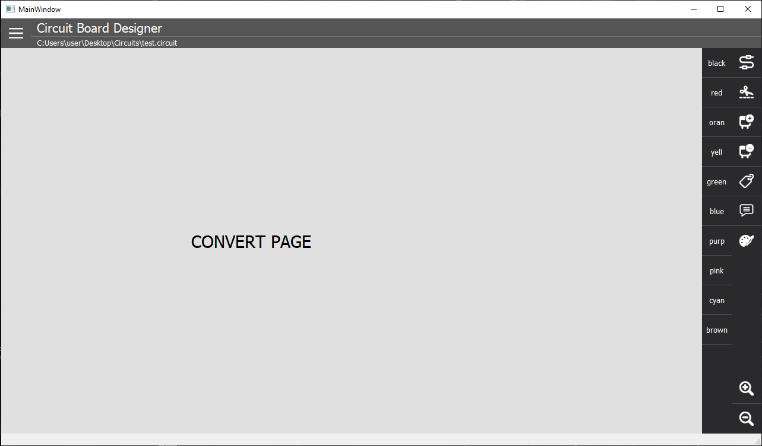

Slide 8
GUI:
Partially Completed Items
The partially completed items include;
Drag and Drop
Coordinate acquisition
Canvas workspace
These three items are all solutions to various needs of the GUI application, but need to integrated together.

Slide 9
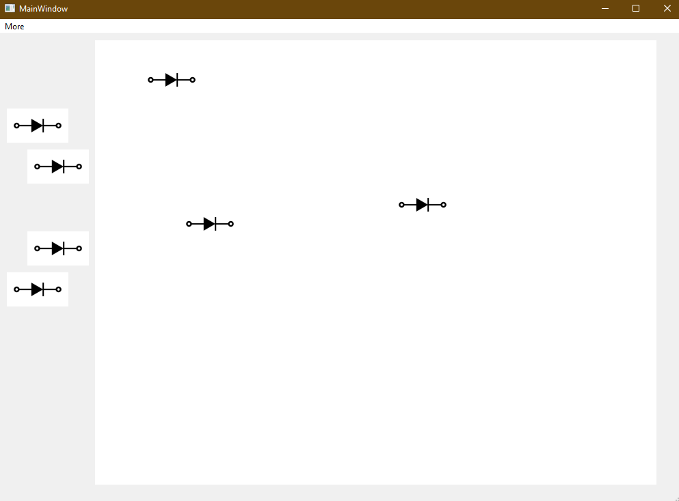
Drag and Drop Functionality
This drag and drop functionality is done by creating a mouseClickedEvent and mouseDropEvent which helps to tell the object when to move and when not to move.
This test on the right is just an example of some diodes than started on the left and have been dragged to the right freely.

Slide 10
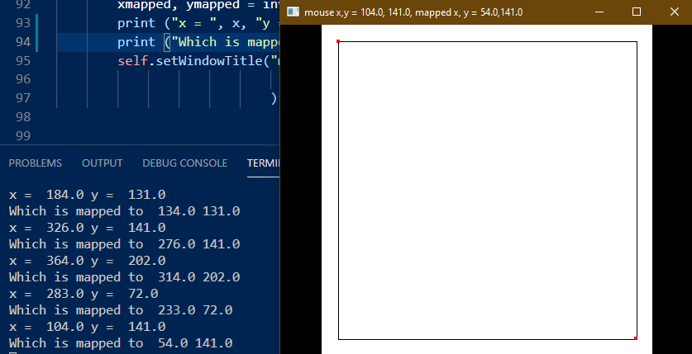
Click Coordinate Functionality
The click coordinate functionality creates a window on screen, and localizes the window coordinates relative to the screen coordinates to help translate screen location to window location.
The image on the left provides a set of examples where clicking on the white box will send the clicked coordinates to the command line output.

Slide 11
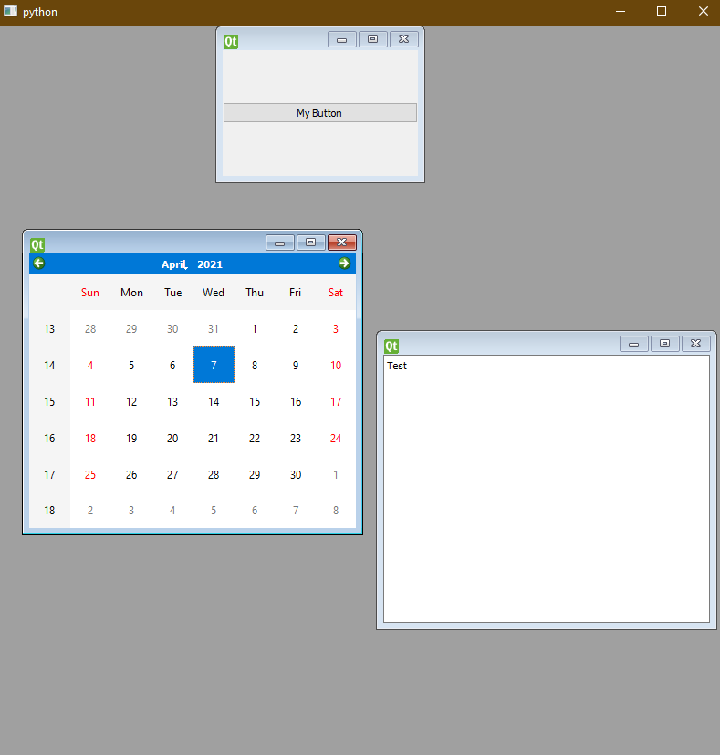
Canvas Workspace Functionality
The Canvas Workspace is implemented similar to the Drag and Drop example, however, it is much more versatile and can be used to integrate the main windows seen in the completed section with the drag and drop functionalities that are seen in this section.
The example to the right show various widget which operate and can be moved around in the main window.

Slide 12
GUI:
Items that still need to be implemented
The primary piece of implementation that needs to be done is integration. All of the solutions in the partially completed items section need to be implemented using one streamlined method. This then needs to be integrated with the main window functionality seen in the completed section.

Slide 13
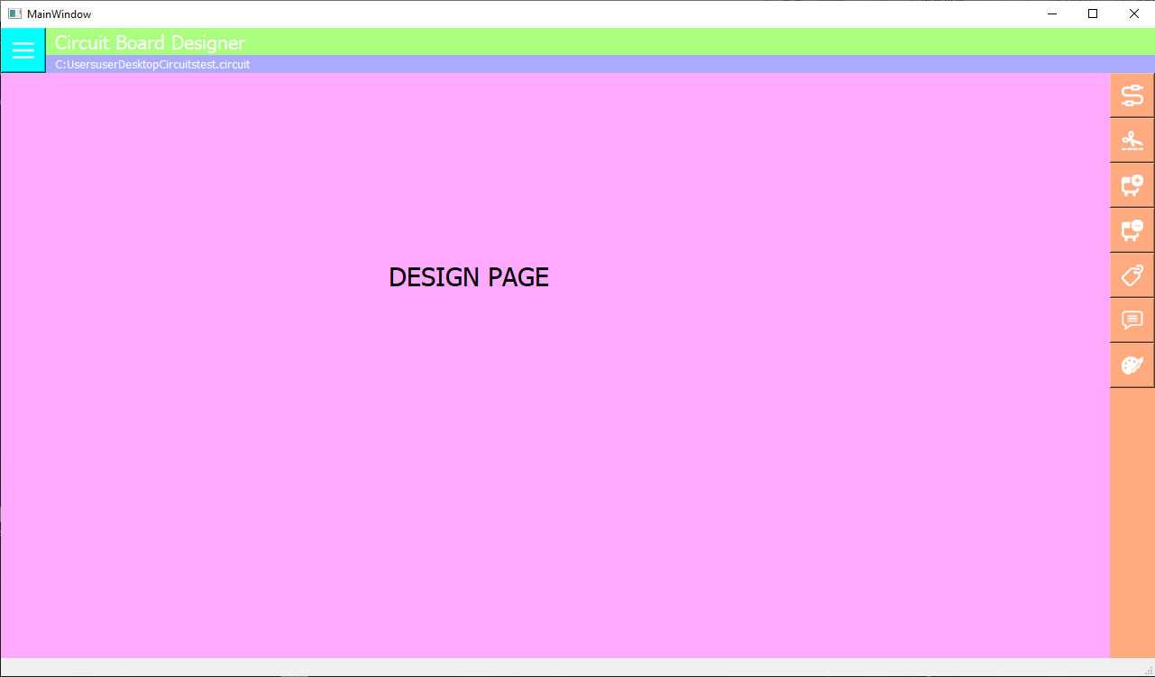

Slide 14
GUI:
Other smaller things are still need to be implemented are:
Sending click coordinates to the Monte Python section to process the schematic.
Finalized svg drawings of all of the components
Ability to change colors of lines

Slide 15
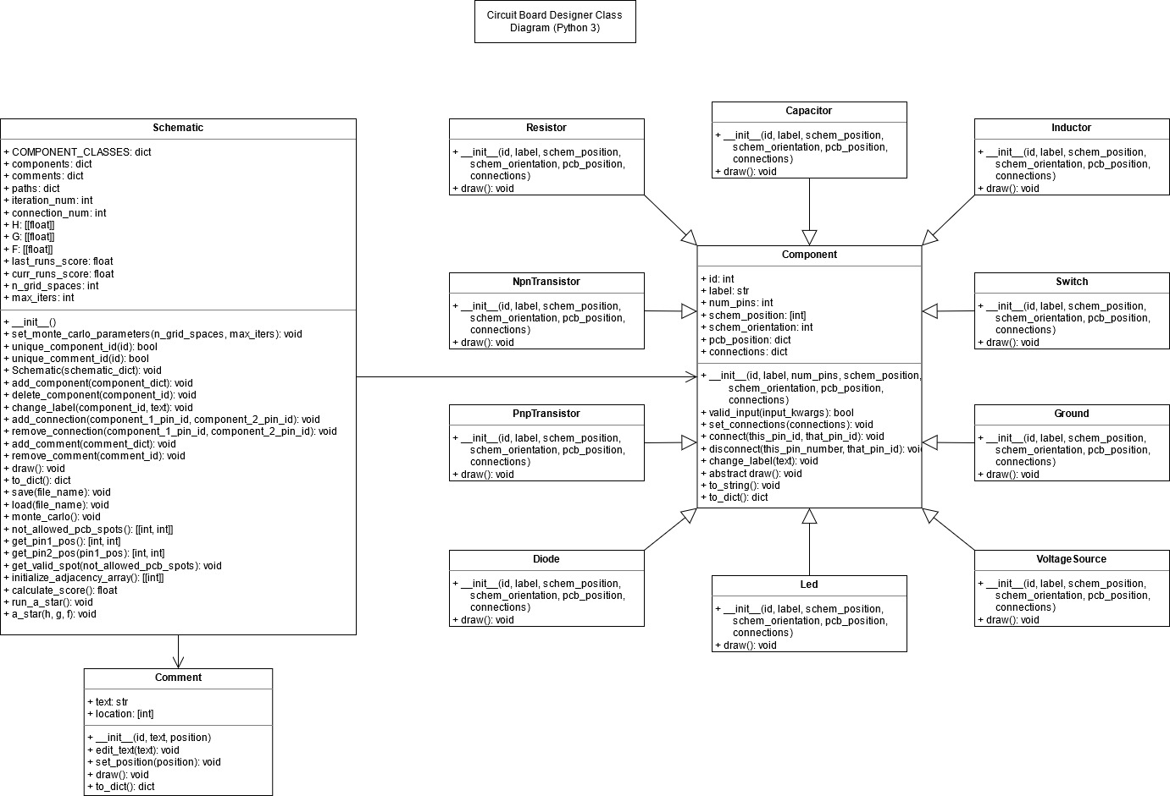
Classes:
Completed Items
Partially completed items
Items that still need to be Implemented
Class Diagram Link

Slide 16
Classes:
Completed items
Adding and deleting components to a schematic instance.
Connecting and disconnecting component pins.
Adding and removing comments.
Editing component labels.

Slide 17
Classes:
Partially completed items
Save and Load work for the Schematic class. However,
save() just throws an error if the file already exists.
load() just throws an error if the file doesn’t exist.
Component svg images.
The randomizing pin positions function can sometimes get stuck.

Slide 18
Classes:
Items that still need to be implemented
Tying functions to the GUI.
Create New, Open, Save, Save As -> Schematic.save(), Schematic.load(), and new Schematic()
Create/Snip wire -> Schematic.add_connection() and Schematic.remove_connection()
Add/Delete Component -> Schematic.add_component() and Schematic.remove_component()
Add/Edit/Remove Comment -> Schematic.add_comment(), Schematic.edit_comment(), and Schematic.remove_comment()
Edit Label -> Schematic.edit_label()
Drag and Drop Component -> Schematic.draw()
Schematic.draw()
Clicking on a components’ pin in the schematic view.
Implementing a basic svg editor using an xml library
A* and the auxiliary functions it uses.

Slide 19
Issues to the project:
GUI Issues:
Can’t integrate the coordinates and the drag and drop functionality together.
Class Issues:
Communication with the GUI.
Converter Issues:
Unclear how to specifically implement the mapping from grid space to a physical pcb.
Potential Fix for GUI:
There is are classes in QT called qGraphicsView and qGraphicsScene that does most everything we need for the UI. It has a built-in canvas, allows objects to be easily added to a scene, and easy movement where every object has its own position.

